Slide 1

VIRTUAL ASSISTANT
Submitted To:
Ms. Prabhleen Juneja
Submitted by:
Abhishek Sharma
101503008
Coe-1

Slide 2
Functionalities
It can open any site for you where you can find anything you want to find.
It can tell time, name, reboot system and other basic operations with operating system.
It can open the place in the maps which you want to explore.
It can tell the Hindi meaning of any English word.
It can tell the weather of the place you queried.
It can Play any song of your choice.
It can search games you want to play.
It can scrap text from Wikipedia and read the text for you.
It can tell you a joke.
It can search any query on google search engine.

Slide 3
Working
Speech Recognition – Google
Text to Speech – Google
Beautiful Soup – Web Scrapping
JSON Parsing
Regex
OS – Interacting with System
Time – System Time

Slide 4
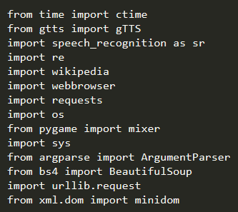
Algorithm

Slide 5
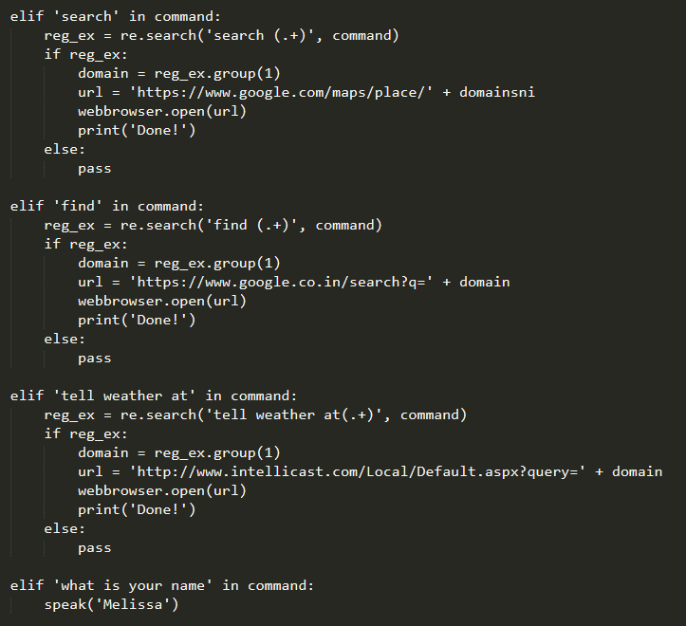
Functions

Slide 6
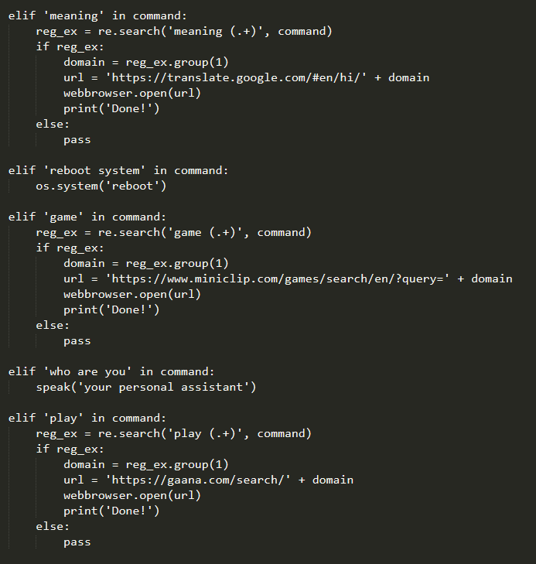

Slide 7
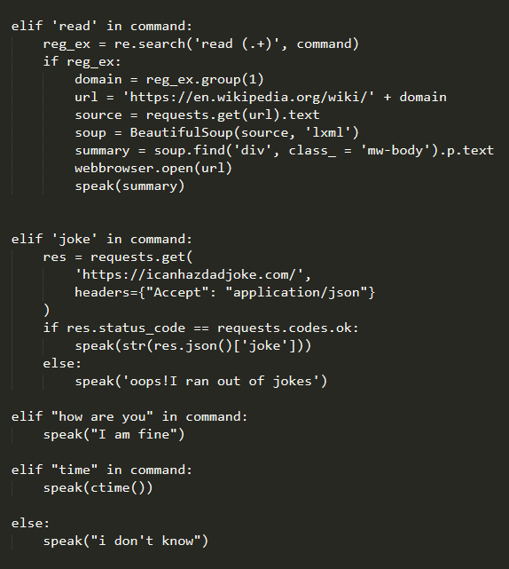

Slide 8
Conclusions
Personal Assistant to do basic functionalities.
Ask the basic queries.
More functionality can be added in the future such as to do the functionalities like the other API’s are providing for example – Google , Amazon etc.

Slide 9
References
Giovanni Campagna, Rakesh Ramesh, Silei Xu, Michael Fischer, and Monica S. Lam. Almond: The architecture of an open, crowdsourced, privacy-preserving, programmable virtual assistant. In Proceedings of the 26th International World Wide Web Conference (WWW-2017), 2017.
Monica S. Lam, Giovanni Campagna, Jiwon Seo, and Michael Fischer. A distributed open social platform for mobile devices. In Proceedings of the International Conference on Mobile Software Engineering and Systems, MOBILESoft ’16, pages 173–174, New York, NY, USA, 2016. ACM.
Panupong Pasupat and Percy Liang. Compositional semantic parsing on semi-structured tables. In Proceedings of the 53nd Annual Meeting of the Association for Computational Linguistics (ACL-15), pages 1470–1480, 2015.
Yushi Wang, Jonathan Berant, and Percy Liang. Building a semantic parser overnight. In Proceedings of the 53rd Annual Meeting of the Association for Computational Linguistics (ACL-15), pages 1332–1342, 2015.

